Slide 1

Activate Prior Knowledge:
    Matter has mass and volume.
    Matter is made of atoms.
    Matter exists in different states.
Essential Skills:
    Describe physical and chemical properties.
    Give examples of physical changes.
    Explain that chemical changes form new substances.
    Observe signs of chemical change in an experiment.

Slide 2
Standard:
  Structure of Matter 8.2.1: Explain that all matter is made up of atoms that are far too small to see directly through an optical microscope.
  Warm up:
  Describe a common object by naming its distinctive properties. Trade your mystery- object description with a partner’s and try to guess what object he or she has described.

Slide 3

Chapter 2: Properties of Matter
          Big Idea: Matter has properties that can be changed by physical and chemical processes.
          Matter has observable properties
          A. Physical properties describe a substance.
          1. Physical properties of a substance can be observed without changing the identity of the substance.
          2. Density, mass, color, size, volume, and texture are examples of physical properties.
          3. Density is the relationship between the mass and the volume of a substance.
          a. Calculate density by dividing mass by
          volume.

Slide 4

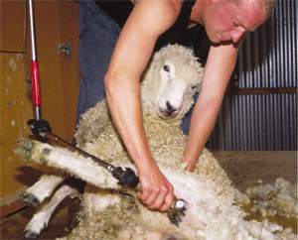
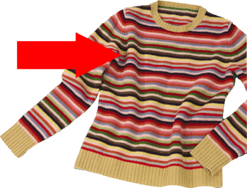
Chapter 2: Properties of Matter
      4. Physical change is the any change in a physical property of a substance.
      5. The identity of the material remains the same during the change.
      6. Example of physical changes include cutting a material, breaking it, and changing its state.

Slide 5
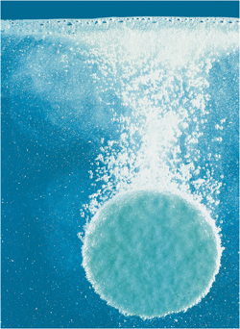
      Chemical properties describe how substances form new substances.
      1. To observe chemical properties in a substance, you must see a chemical change.
      2. To observe the combustibility of a piece of paper, for example, the paper must burn.
      3. The products that result form burning the paper differ identity from the paper.

Slide 6

Chapter 2: Properties of Matter
4. Signs of a chemical change include the production of an odor, a gas, or a solid and a change in temperature or color.
5. Other examples of chemical properties include reactivity, tendency to corrode, and toxicity.

Slide 7
Vocabulary Terms:
  physical property :A characteristic of a substance that can be observed without changing the identity of the substance.
  Density: A property of matter representing the mass per unit volume.
  physical change: A change in a substance that does not change the substance into a different one.
  chemical property: A characteristic of a substance that describes how it can form a new substance.
  chemical change: A change of one substance into another substance.

